Slide 1

Mess Management System
Group Members:
Touseef Ahmed
Umair Ahmad
Zunaira Akbar
Rehan Mahmood Farooqi

Slide 2

Features :
Login / Sign Up
Menu Management
Order Management
Billing System

Slide 3
Login & Sign up
Header File
MaxUsers, users array
Menu loop
Show existing usernames
User Input/Switch
Read usernames from file
Handle options

Slide 4
Login & Sign up
New user registration
Program exit
Error Handling
File :Read/write usernames
User login
Handle invalid choices

Slide 5

Menu Management
Store Data
Select Day
Invalid Input Handling
User interface Colouring
Read data from Menu File
User Selection
Menu Indexing
Select Full/Breakfast/lunch /Dinner
Display Selected Menu
This Photo by Unknown author is licensed under CC BY-SA-NC.

Slide 6

ORDER
Order Entry Loop :-> Restrictions
Handling Counter Cases:-> Dynamic Ordering Loop
User Guidance:-> Full Day Menu
Ordering Process :-> B/L/D
Dynamic Menu Item Ranges
Order Menu Function Call
Valid Index Checking
Default Case Handling
User Interaction Loop

Slide 7
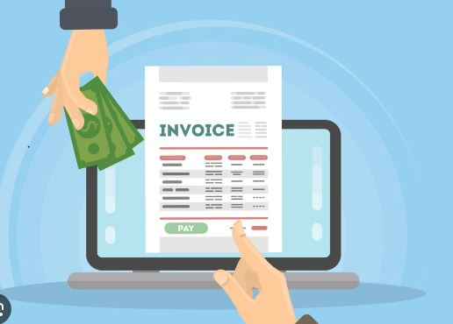
Order Management
Display Current Order
Add & Remove Item from Order
Billing Information
User Interaction
Indenting & Formatting of whole code
Overall code management

Slide 8
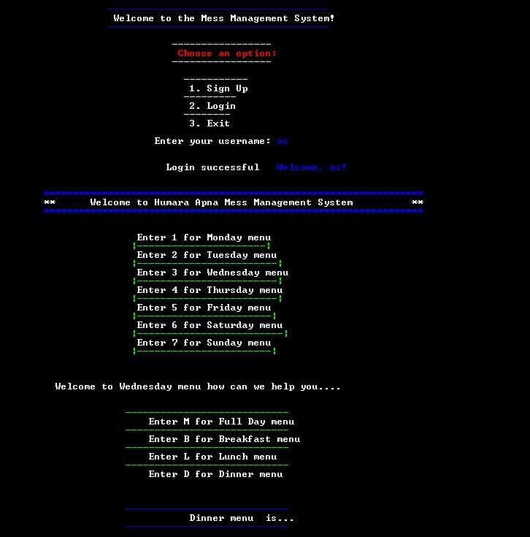
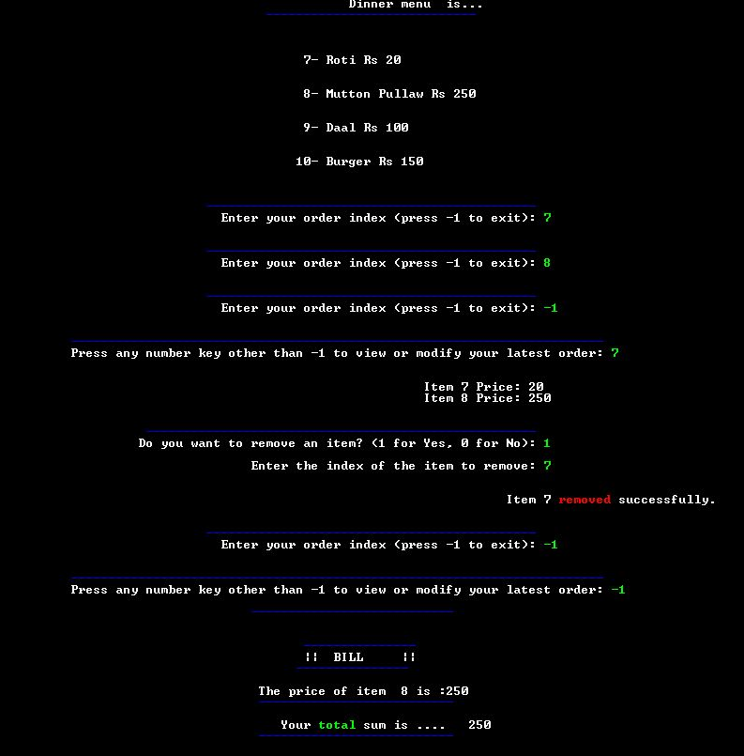

Slide 9
